Slide 1
A Tale of
Trees, Crime, and Apples on
Seattle’s Beacon Hill.
Making the Jungle a Garden Again

Slide 2
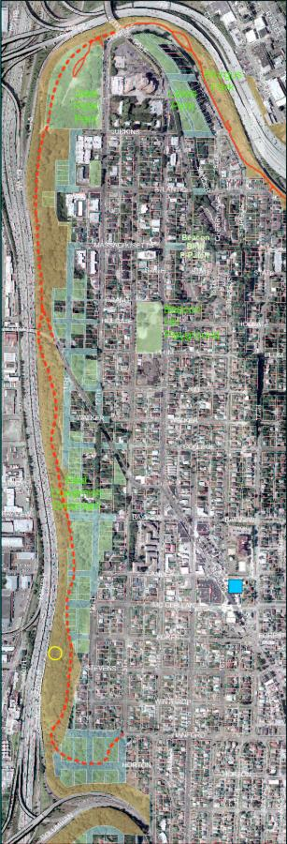
The Jungle
Seattle’s most notorious forest
WSDOT, Parks and Recreation, SDOT, SPU, some private property
From I-90 south along I-5, to Tukwilla, 250 acres
1930’s Hobo Jungle – Name stuck.
The East Duwamish Greenbelt
  Native Trees – Broad Leaf Maples, Cedars, Firs
  Exotics - Norway Maple, Common Hawthorn
  Midstory – Cherry Laurels, English Holly
  Canes and Climbers – English Ivy, Climatis, Knotweed, Himalyan Blackberry
  Meadows – Scotch Broom, Poison Hemlock, Bindweed,

Slide 3
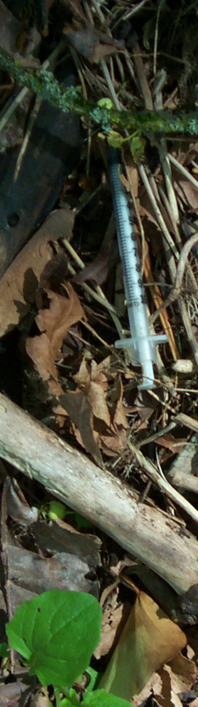
The Business
Narcotics & Pacific NW: 20th Century Agreement
  South of US/Canada border, US, Mexican syndicates, tar heroin
  North of border, Canadian, Chinese Triads, China white heroin
Winter 2002 / 2003: Deal breaks down.
  Large amounts of Asian heroin available in Seattle
  Jungle becomes dope central
  9 arrests of organized crime ring, 43 others
2002 – 2009: Many players.
  Uncle, Mister Big, and the Upper Valley
2010 – present: Mergers.
  Mexican / Pan Pacific suppliers, cross-US distribution
  Three-county hub (Snohomish, Pierce, King) for Washington State
Current business plan:
  Collaborative sourcing along supply chain
  Competitive street market – gangs, territory, customers
  Heroin, cocaine, meth

Slide 4
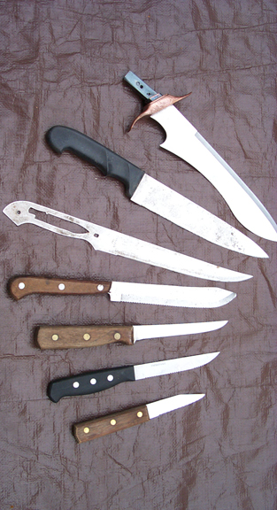
The Crime
24 deaths
  11 homicides
  4 suicides
  5 highway
  3 undetermined
  1 accident
Home burglary, car prowls,
strong arm robbery
Homeless people targeted
The Assaults: June 21-23, 2008
…Something had to be done.

Slide 5
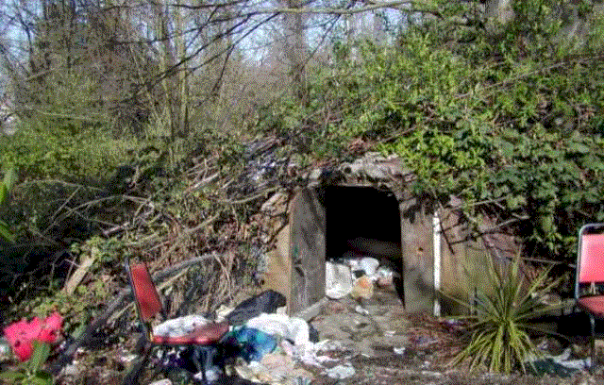
The Bunker - 2003

Slide 6
CPTED - Background
Crime Prevention Through Environmental Design
Usually applied to urban built areas, popular acronym
Clear cuts, lights, lights, and more lights
CPTED plant list, 2003
  English Holly and Chinese Holly
  7 Barberries
  Juniper, Oregon Grape
  Longleaf and Creeping Mahonia
  Thorny Eleagnus, Scarlet Firethorn, Rugosa Rose, Salmonberry
  Thorns, thorns, thorns
Notes:
Hough Beck & Baird plant list (distributed by Seattle Neighborhood Group, 2003):

Slide 7
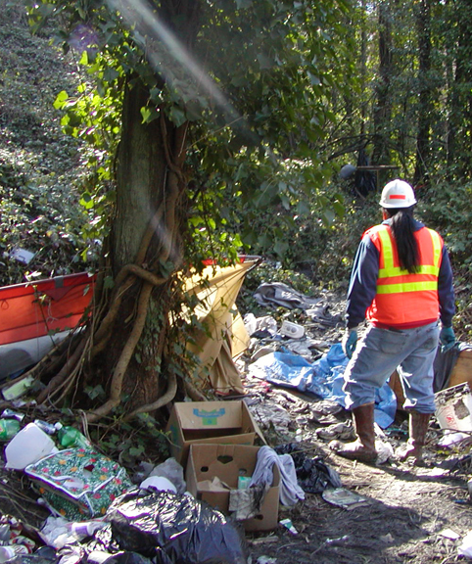
Response - 2003/2004
Greg Nickels / Jordan Royer
Interagency Task Force:
  Neighborhood Action Team:
  Mayor’s Office
  Seattle Police Dept.
  Seattle Dept. of Neighborhoods
  Seattle Parks & Recreation
  Seattle Neighborhood Group
  Human & Health Services
  Seattle Public Utilities
  Seattle Dept. of Transportation
  Washington State DOT
  Washington State DOC

Slide 8
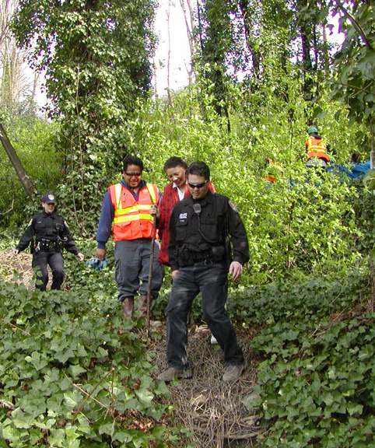
Response – 2005/2013
2005/2009
  SPD, DON, Parks, SDOT, SPU
  WSDOT, WSDOC
  GSP
2010/2013
  Mountains to Sound Greenway
  DM Darryl Smith
  City Fruit -
  Orchards and the Farm
Non-profits/Schools/Companies
  Contribute programmatic
  consistency
2014 - TBD

Slide 9
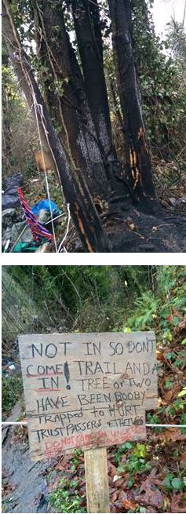
Current Challenges
SPD: Property owners (inc. city/state agencies) responsible for taking care of their own
property, will not pro-actively respond to issues on the ground unless threat-level is high
City policy of 3-day posting for removal of
camps in forested areas not consistently enforced; in some areas, social service agency tasked with outreach has not entered
Selective enforcement of city encampment protocols
Construction/destruction (“the Digger”)
Citizens Bureau – 145 days to respond to “daily issues of human waste, empty liquor containers, syringes, trespassing, harassment, drug dealing, a murder, a foiled home invasion, a light rail closure, and two fires”

Slide 10
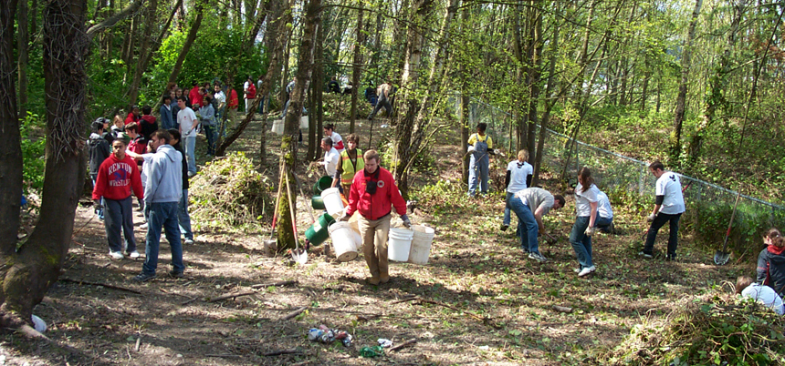
CPTED from the Ground Up
More intensive maintenance, including thinning selective species (Indian plum)
Plant species that encourage habitat while discouraging habitation (native roses, cascara, native blackberry, salmonberry)

Slide 11
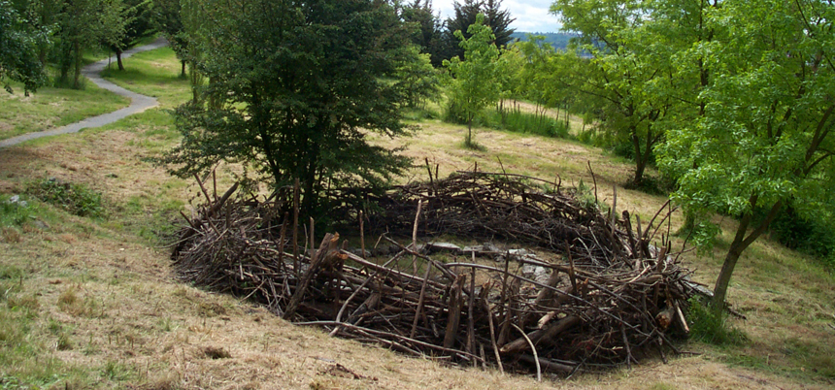
CPTED from the Ground Up
Collect and use materials from work parties to create barriers; mulch “fence” vs. piles; several stacks strategically placed; large stacks to cover trouble spots; invasive blackberry and holly to block trails selectively.
Create brush piles/fences/structures that will attract song birds. Be creative – like Andy Goldsworthy!

Slide 12
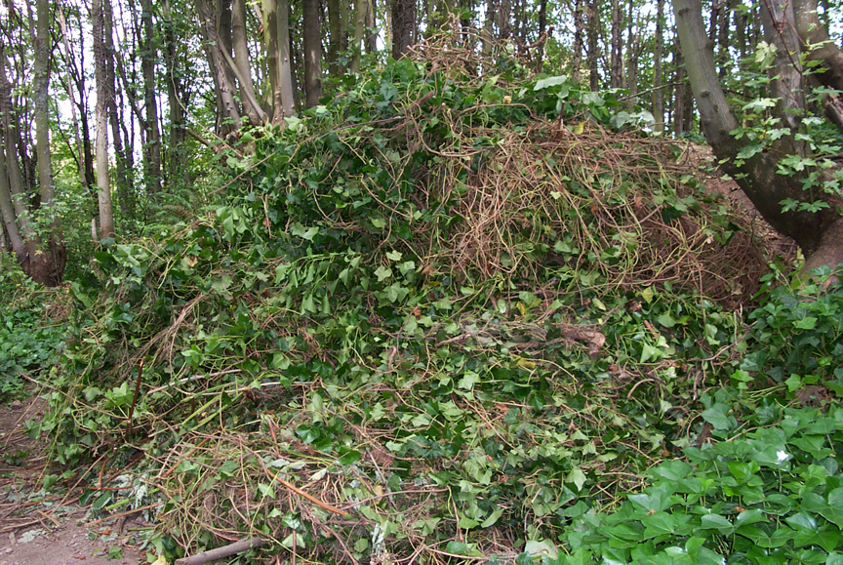
Design for the Situation
9-feet deep mulch pile covering former meeting spot for junkies, dealers, prostitutes, created by EarthCorps summer 2008. This is 5-feet higher than usual.

Slide 13
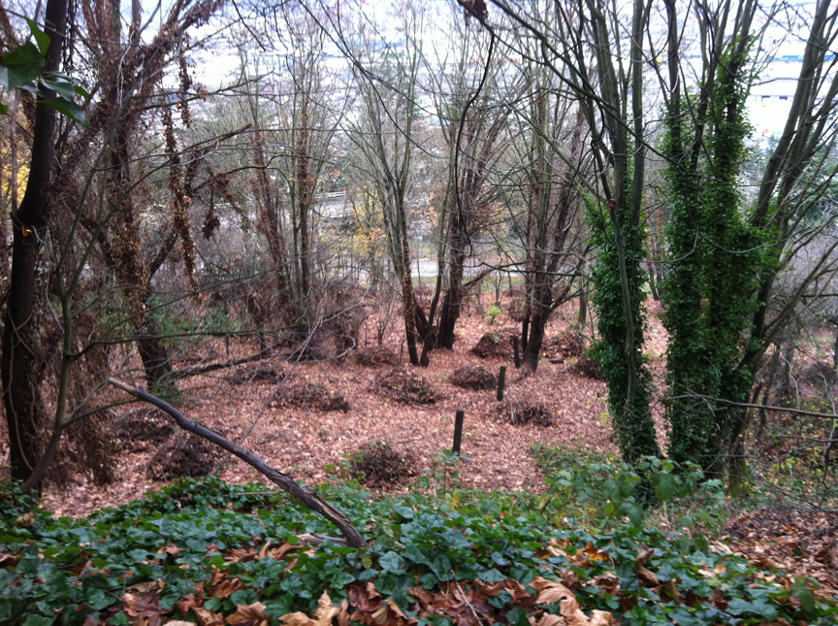
Design for the Situation
2-3 feet deep mulch piles spread at Farm off Holgate in fall 2011. Parks/Seattle Conservation Corps broke piles from earlier work into smaller ones to open lines of sight off Mountains to Sound Greenway Trail.

Slide 14
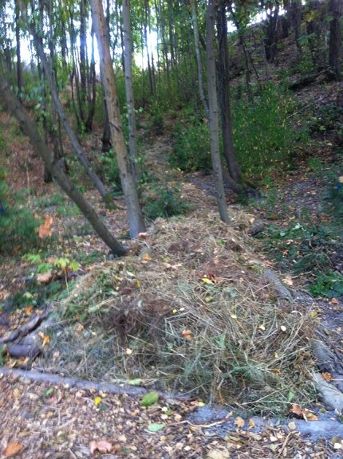
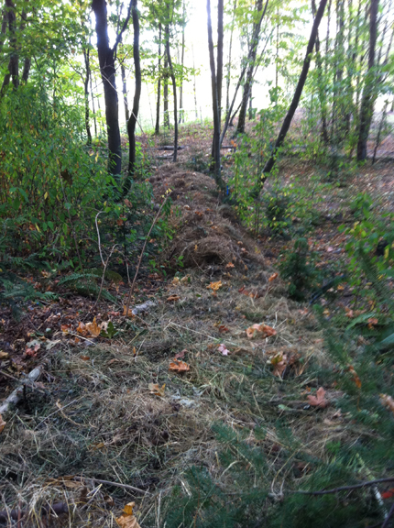
Design for the Situation
Mulch line trail, 2-3 ft high, 45 ft long, using cuttings from cleanup, Dr. Jose Rizal Park, 2012. Large social trail leading onto historical slide area filled in. Mulching process still happening May, 2014, now service trail for restoration / public access.

Slide 15
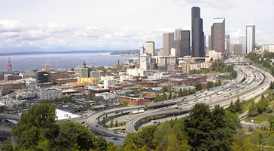
Layered Restoration
Plant in stages; remove holly, blackberries, etc., last from areas that border residences/roads.
Layer plants by density/height. New plants closest to trails provide habitat but do not interrupt line of sight. Establish small meadow and wetland systems.
Incorporate trails into the layers by outlining them with materials on hand – logs, branches, rocks, concrete, asphalt: people tend to stay on trails, so use them to route walkers.
Wildlife will need buffer zones from people – layering helps establish them.

Slide 16
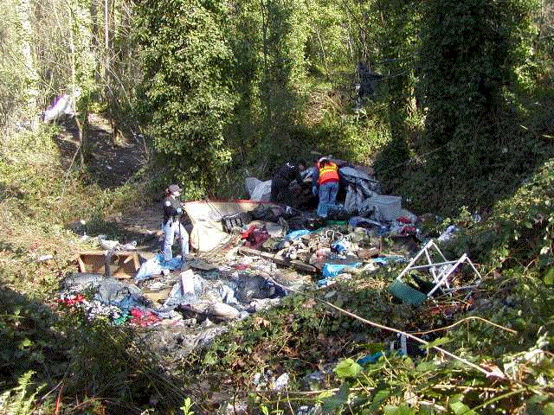
Be prepared to pick up the trash!
Establish an easily accessible staging area for pick-up.

Slide 17
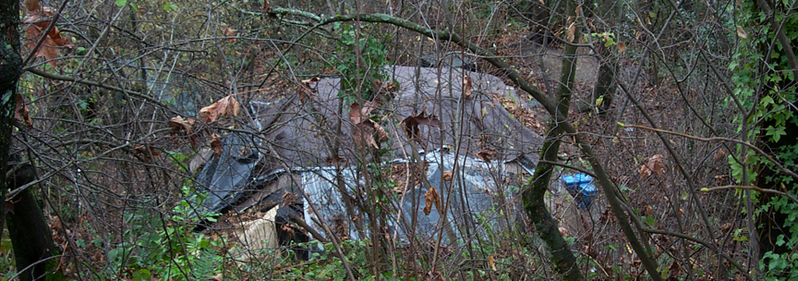
Encampments
Encampments are entrenched, built-up sites that include several camps.
Do not clear actively occupied campsites. Contact the Citizens Bureau, and contact the property owner separately.
Do not enlist campers to do work.
Abandoned sites: treat respectfully. If it looks like someone will be back, give them chance to return. If objects must be moved, put them to one side and leave them. You can always return to see if they’ve been claimed.

Slide 18
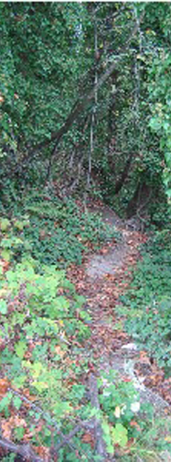
Social Trails
The Jungle has a large network of social trails created by people living there.
Many are useful as stewardship trails, but many simply lead to a tent, so they should be approached with care.
The trails in lower Dr. Jose Rizal Park were originally social trails.
The access trail to the orchard by our overlook provides access to the lower park, so the steep social trail that was used before has now been mostly reforested.
If forestry work is planned in areas with social trails, scout out the trail with someone else before the event. Look for:
  Holes – erosion or dug
  Widow-makers along the trail
  Potential human-made hazards

Slide 19
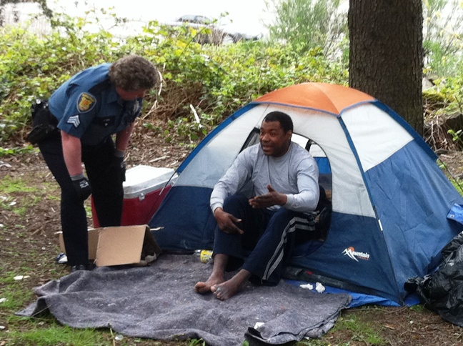
People living in the woods…
Should be treated with
respect.
Most homeless people
are not violent.
Some people live in the
woods for their own
reason – not all live in
encampments, not all are
affected by cleanups.
People who live in the
woods have a better understanding of what’s happening on the ground.
Not all people who live in the woods trash the woods – Red and Montana.

Slide 20
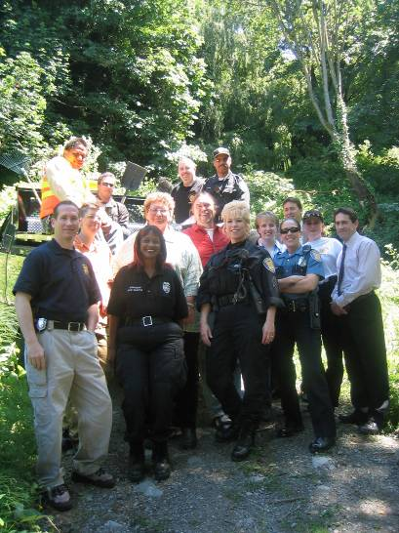
"As a direct result of the collaborative efforts of the many involved organizations, the Jungle project has proved a great success and the area is being returned to the community."
Seattle Police Department
2004 Annual Report

Slide 21
  Sort of…..
Working in the woods has its highs
and lows.
The city/state relationship and other
stakeholder relationships may affect
projects.
City politics may create barriers,
work may not be budgeted (SDOT,
SPU, SPD, Parks).
2 steps forward – 1 step back:
work still gets done in less time than anticipated.
Personal relationships are key to getting it done.
Staff retires or reassigned – continuing need for in-service training, project education and advocacy.

Slide 22
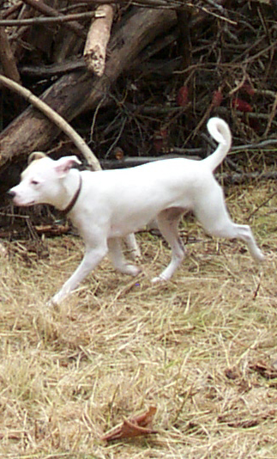
Dogs?
You can’t tell a dog owner to get the hound out of here.
“Nice dog! Where’d you find him/her?”
“There are coyotes and raccoons in these woods, and skunks.” Skunks will usually get the dog on leash again.
Strays, call Animal Control –2-3 Animal Control Officers in Seattle.
Some homeless campers have dogs.
If homeowners let dogs loose, and you feel threatened, call SPD. Get photos.
COLA stewards if available.
Beware of activists (dog and otherwise).
Protect plants with temporary barriers if necessary (sticks, branches, cut brush), or entire areas with mulch lines, etc.

Slide 23
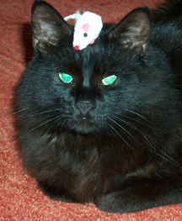
Cats?
Feral cats are a problem for wildlife
and themselves.
Well-meaning people feed them,
attract coyotes and raccoons.
You can’t convince a public cat fancier
to stop feeding cats in parks.
Some colonies are maintained by
volunteers – some of the volunteers
will construct structures in wooded areas
for the cats.
If they are well-tended, leave them alone;
WSDOT employees in the past rescued
several feral cats and gave them homes.
If a feral cat station is a mess, clean it up, especially the food.
Make room for the feral cat project in your restoration area.

Slide 24
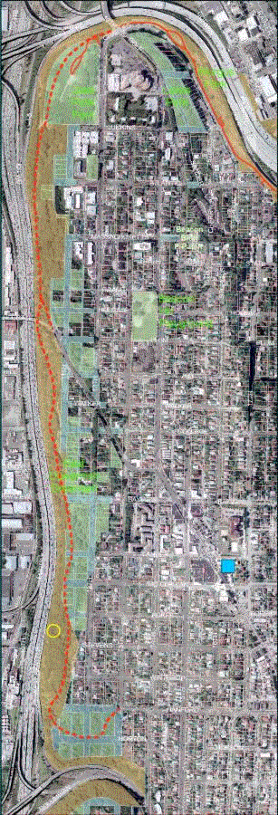
The Larger Plan
Collaborative, overlapping projects – it’s all the same forest
Re-establish city/state interagency taskforce model – must happen at the mayor’s office
Outreach to non-forestry but related groups: COLA, City Fruit, M2S Greenway, Feet First, bike groups, urban agriculture
Outreach to first people, Duwamish culture
Habitat zones – low human impact
Knowledge exchange – between stewards
Complement and advocate for other woods, orchard, habitat, and native agriculture projects
Encourage neighbor and community use
Culture of sustainable care

Slide 25
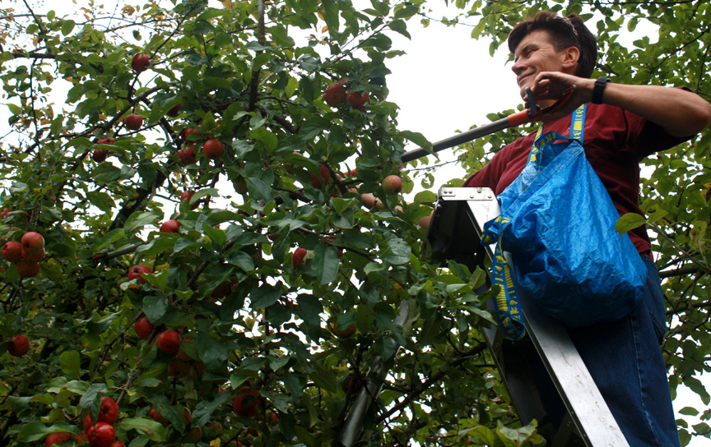

Slide 26
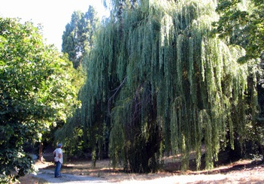
What’s the Jungle Like Today?

Slide 27
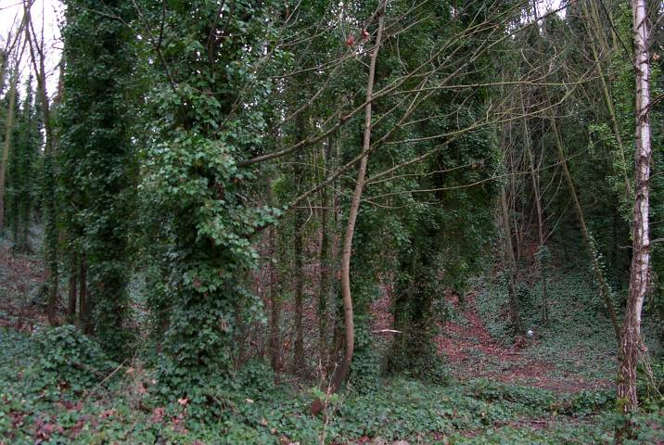
2002…

Slide 28
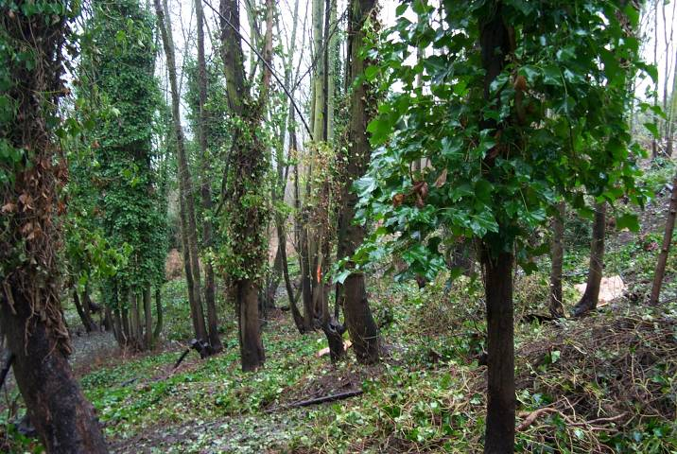
…2005

Slide 29
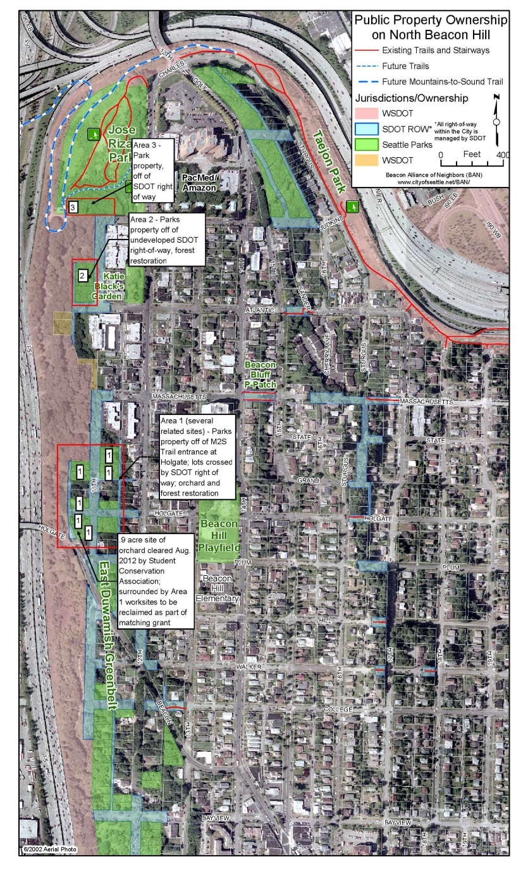
The Places
Complete the pedestrian trail
Practice orchardry, forestry
Recover … The Farm
Encourage non-profit and public urban agriculture
Harvest organic fruit for neighborhood, food banks, and
food services
Engage diversity – Filipino, Chinese, Japanese, Vietnamese, European, African, Native American people
Have fun! National Night Out:
2000 – 1 block party
2013 – 8 block parties

Slide 30
In 2005…
400 native trees and other plants saved
10,000 sq. feet of English ivy / exotics removed
Over 1000 “boots on the ground” volunteer hours
5 large volunteer work parties (300 people), and several small neighborhood cleanups
Seattle Green Partnership site
1 Forest Steward, 1 Seattle Tree Steward
Project Extended to Lewis Park and 3 Public Stairways

Slide 31
In 2013…
Ivy/invasive control 3,000+ trees, 60 acres
15,000 native trees, shrubs, ferns planted
Tens of thousands of wildflowers
Habitat enhanced for 35 species of native birds, 8 mammals, garter snakes and bats
Dr. José Rizal Park apples – 53 true and crabs
  2011: 300 lbs
  2012: 500 lbs
  2013: 550 lbs
The Farm – 15 Italian plums, 3 pears, 2 cherries, 1 walnut so far…

Slide 32
What’s Next?
Native food (blue camas, nodding onions, oaks)
Expansion of orchard project
Continuing agreement with City and WSDOC for maintenance – now lapsed
SDOT funding for maintenance for Mountains to
Sound Trail
SPD greenbelt specialty team
Neighborhood Action Teams
Landscaping / temporary art installations
Signage – orchard and forest
Farm restoration
Continuation of public trail system south of Holgate
Restoration of Bayview Stairs into EDGB
Rebuild herpetarium
More skunks
Re-introduce foxes, grizzly bear
One big park – part of one big forest

